Slide 1


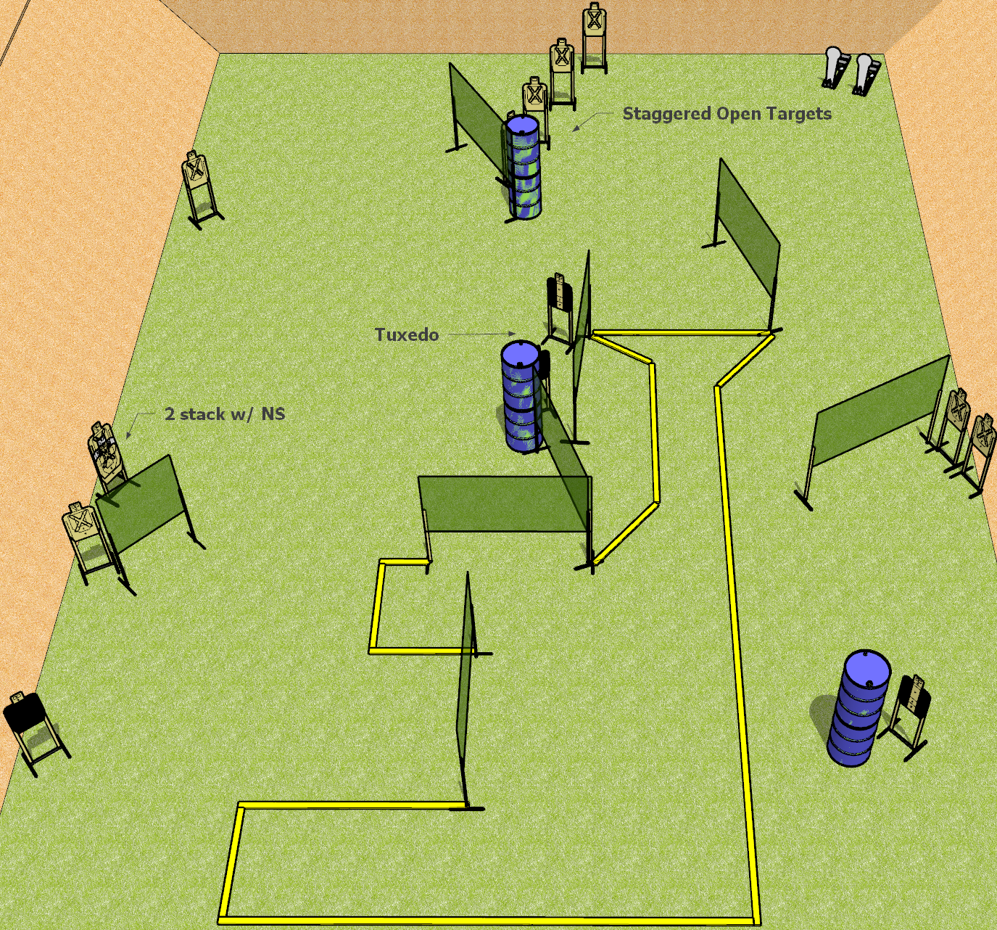
 | Dothan Gun Club – USPSA Match Top of the Funnel Course Designer : Drew Coleman
START POSITION : Standing anywhere inside the shooting area, wrists below belt
GUN READY CONDITION : Pistol loaded and holstered. PCC loaded, buttstock on belt, safety on, pointed in a safe direction. |  | SCORING: Comstock, 30 rounds TARGETS: 14 paper, 2 Steel SCORED HITS: Best 2 on paper, steel until down START-STOP: Audible, last shot RULES:
STAGE PROCEDURE: Engage targets as they become available from within the fault lines.

Slide 2
Top of the Funnel
Written Stage Briefing
Top of the Funnel is a 30 round, 150 point, Comstock Field course. There are fourteen USPSA targets and two colt poppers. The best two hits on paper will score, and steel must fall to score. The start signal is audible.
Handgun start position is standing anywhere inside the shooting area, wrists below belt. Handgun is loaded and holstered.
PCC start position is standing anywhere inside the shooting area, muzzle pointed in a safe direction. Loaded carbine is held with both hands, safety on, buttstock on belt.
On start signal, engage targets as they become available from within the fault lines.

